Slide 1
Web & Document Accessibility
Common Issues and Examples

Slide 2
Why is it important?
“Under the Accessibility for Ontarians with Disabilities Act (AODA), all large (50+ employees) private and non-profit organizations and all public-sector organizations are required to make their websites accessible.”
“...by January 1, 2021, all public websites and web content posted after January 1, 2012, must meet WCAG 2.0 Level AA.”
WCAG 2.0 is an international standard for web accessibility that helps users with a wide range of disabilities access content more effectively. WCAG 2.0 covers Blindness and low-vision, Deafness and hearing loss, Learning disabilities and more.
Level AA requirements include issues with contrast, images, text formatting, navigation and more. To access a more comprehensive list, view WUHCAG’s Accessibility Checklist.
Notes:
Quotes from https://www.aoda.ca

Slide 3
“Click Here” Links
Links placed on text such as “here” or “click here” are not very accessible. Someone navigating the page through links alone might not know where the link goes. The word “click” also does not include or help users who are using input devices other than a mouse.
Not Accessible:

Slide 4
(Solution)
An easy way to make these links accessible is to place each link on some text that specifically describes what the user will be linked to. This way if the user is crawling the page through links, they know where each one goes.
More Accessible:

Slide 5
Links on Typed-Out URLs
Another issue with link text arises when a link is placed on the full URL of the page the link leads to. These links are difficult to read, especially if there are many on a single page. They also present problems for screen readers, which will read every character of the URL.
Not Accessible:

Slide 6
(Solution)
This issue can be solved the same way as issue #1. If the link text is placed on something easily read that also uniquely describes the page or resource.
More Accessible:

Slide 7
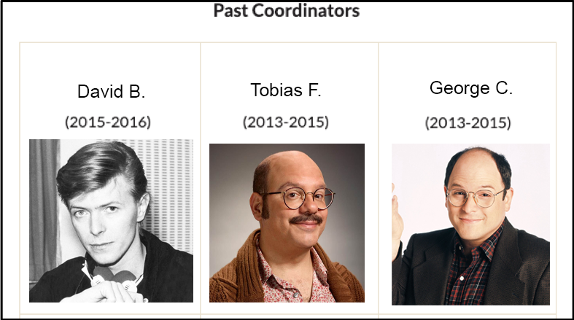
Non-Tabular Data in Tables
Tables can present accessibility problems and should only be used when they are the best way to present your data. If you have images to display, a table isn’t the best solution. Tables are best suited to holding data, and shouldn’t be used for page design or layout.
Not Accessible:

Slide 8
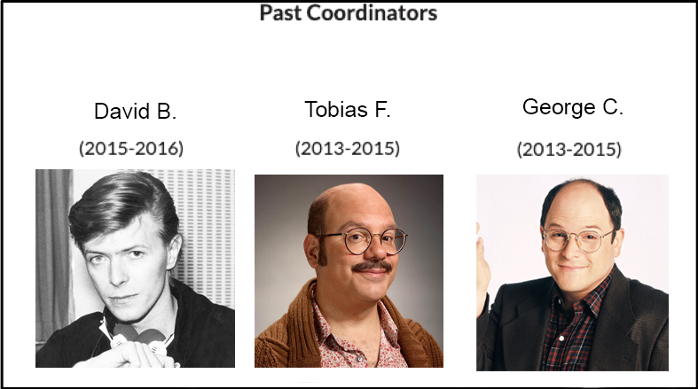
(Solution)
The solution to this issue is to not use a table. The example below has nearly identical styling, but no table has been used.
More Accessible:

Slide 9
Image Alt Text
Unless an image is purely decorative, or has an in-text explanation or caption, it should have some alt text. Alt (short for alternative) text is a hidden caption that can be used by screen readers to describe an image to a user. Alt text should tell the user what the image conveys / adds to the piece of content.
Not Accessible:

Slide 10
(Solution)
The best way to fix this issue is to give your image a descriptive alt text that will give the user the gist of what the image is.
More Accessible:

Slide 11
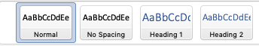

Headers (Word Documents)
Headers are important for web and document accessibility. For this reason it is best to make sure to use proper headers, and not just enlarge the font size or bolden the text.
Not Accessible:
Text is bolded & enlarged, but not actually a heading.

Slide 12
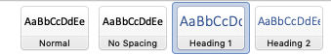
(Solution)
Headers are important for web and document accessibility. For this reason it is best to make sure to use proper headers, and not just enlarge the font size or bolden the text.
More Accessible:

Slide 13
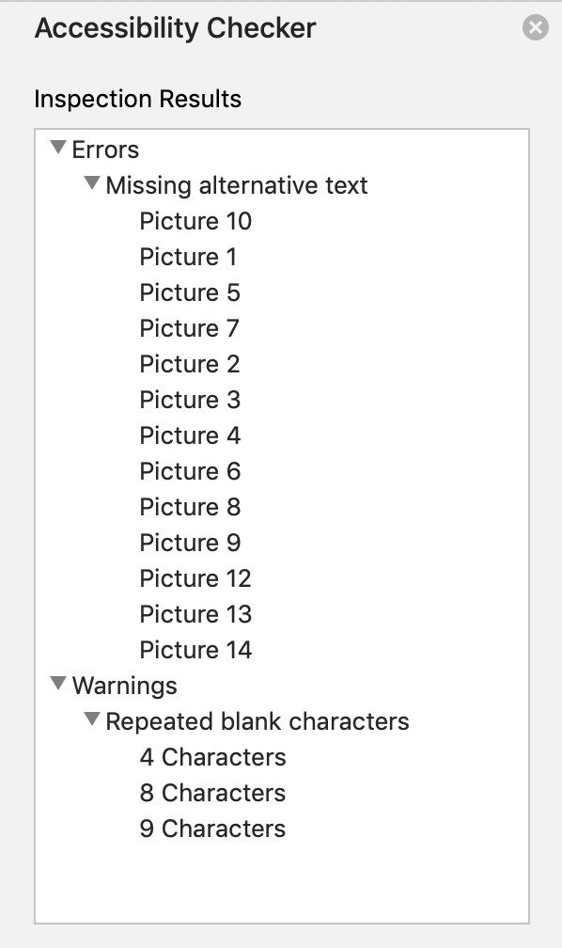
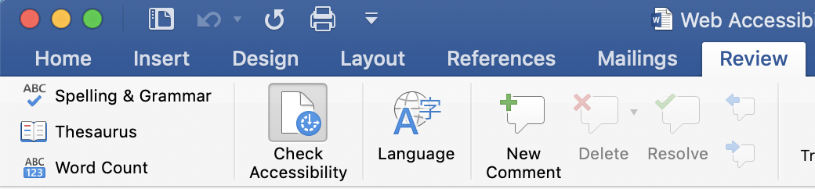
Checking Accessibility with Word
Word lets you check the accessibility of your document so you don’t miss any issues. You can find this feature in the ”Review” Tab. Look for the “Check Accessibility” button.
Clicking the button will give you a list of Errors and Warnings. You can click on them to navigate to them in your document.

Slide 14
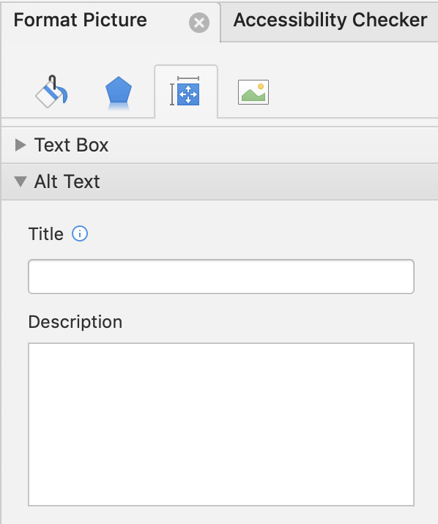

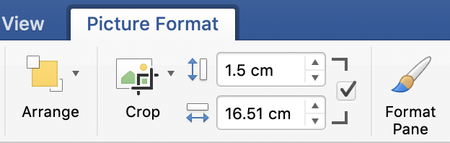
Adding Image Alt Text with Word
To add Alt Text to an image in Word, (1) select the image and locate the ”Picture Format” tab. From there, use the “Format Pane” button (2) . The third button from the left (3) in the Format Pane allows Alt Text and Title to be added to images in your Word Document.
1
3
2

Slide 15
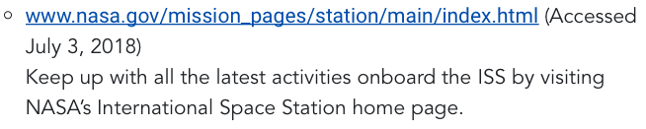
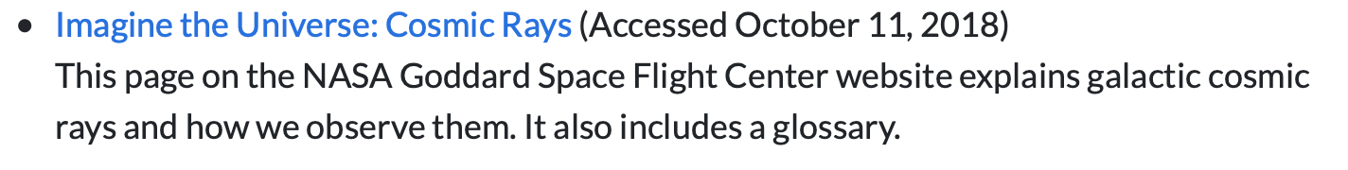
References: Online vs. Print
Referencing style guides differ on how to provide the online location of a source you are citing. Depending on the formality of your document or web asset, you may want to consider the two ways of referencing resource locations. (1) is a Print suitable reference that follows academic style more strictly. (2) Is more suitable for Web and accessible, but doesn’t follow academic referencing guidelines exactly.
(1)
(2)

Slide 16
Further Reading + Tools
Web AIM – A free online education resource for web accessibility.
Web Accessibility Evaluation Tool – Useful online app that checks a website’s accessibility status.
Queen’s University Accessible Word Document Checklist – A simple, easy to use reference for making your word documents more accessible.

